Slide 1

Monitoring Adaptable SOA-Systems using SALMon
Marc Oriol
Jordi Marco
Xavier Franch
David Ameller

Slide 2



Self-adaptive SOA System
Web service
Web service
Web service
Database
Web service

Slide 3

Self-adaptive SOA System
Web service
Web service
Web service
Database
Web service

Slide 4
Self-adaptive SOA System
Web service
Web service
!
Another Web service
Web service
Database
Web service

Slide 5
Self-adaptive SOA System
Web service
Web service
Web service
Web service
!
Another Web service
Web service
Database
Web service

Slide 6
Self-adaptive SOA System
needs:
QoS
SLA
Service
repository
1. monitor services to continuously know their QoS
2. determine when the SLA is being violated
3. take the decision of using an alternative service
Take decisions
+
+
Monitor
Analyze

Slide 7
Quality attributes and metrics

Slide 8
Quality attributes and metrics
What attributes are monitorable?
Accuracy
Availability
Time behaviour
  Response time (of a web service)
  Execution time (of a function of the webservice)

Slide 9
Quality attributes and metrics
Webservice attrs.
Availability
Response time
Current Availability
Average recorery time
Accumulative unavailability time
Accumulative availability time
Current response time
Average response time
Maximum response time
Minimum response time
Operation
attrs.
Accuracy
Execution time
Current functionality compliance
Fault factor
Parameter accuracy factor
Result Accuracy factor
Current execution time
Average execution time
Maximum execution time
Minimum execution time
Notes:
Preguntar si son service attrs o webservice attrs.

Slide 10
Basic metrics
Webservice attrs.
Availability
Response time
Current Availability
Average recorery time
Accumulative unavailability time
Accumulative availability time
Current response time
Average response time
Maximum response time
Minimum response time
Operation
attrs.
Accuracy
Execution time
Current functionality compliance
Fault factor
Parameter accuracy factor
Result Accuracy factor
Current execution time
Average execution time
Maximum execution time
Minimum execution time

Slide 11
Derived metrics
Webservice attrs.
Availability
Response time
Current Availability
Average recorery time
Accumulative unavailability time
Accumulative availability time
Current response time
Average response time
Maximum response time
Minimum response time
Operation
attrs.
Accuracy
Execution time
Current functionality compliance
Fault factor
Parameter accuracy factor
Result Accuracy factor
Current execution time
Average execution time
Maximum execution time
Minimum execution time

Slide 12
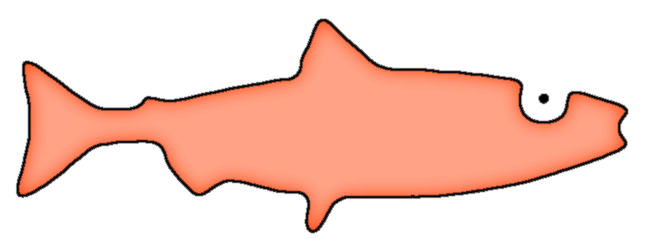
S Mon
L
A
Service Monitor
Level
Agreement
What we need
What we offer:
Monitor
+
Analyze
+
Take decisions
Monitor service
Analyzer service
Decision Maker service

Slide 13
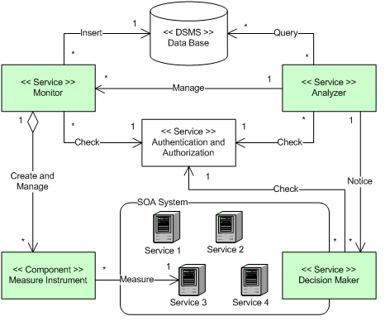
SALMon: Architecture
SALMon Architecture

Slide 14
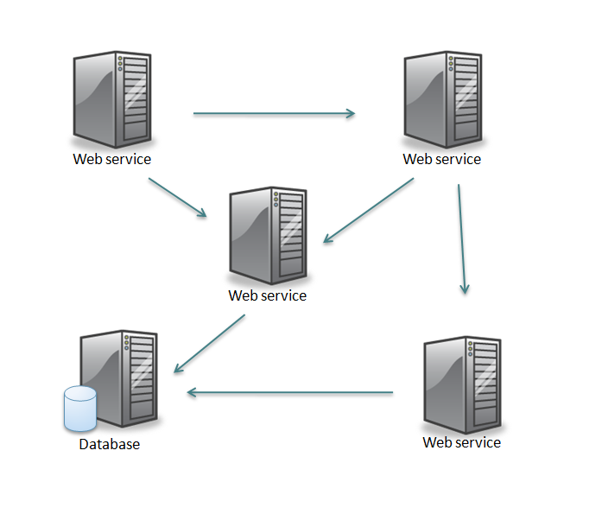
SALMon: Monitor service
Monitor
Monitors 1 SOA System.
Measure instrument
2 kinds:
  Measure instruments for
  webservice attributes
  Measure instruments for operation’s attributes.
Monitors basic metrics actively
(all derived metrics can be obtained from them).
«DSMS»
Data base
«Service»
Monitor
Inserts * 1
1
Create and
manage
*
«Component»
Measure Instrument
Monitored SOA System

Slide 15


SALMon: Monitor service
What basic metrics can we monitor?
Current Availability
Current response time
Current functionality compliance
Current execution time

Slide 16
SALMon: Analyzer service
Analyzer
Manages monitors
Checks SLA .
Notifies SLA violations to Decision Maker.
«DSMS»
Data base
«Service»
Analyzer
Query
* *
1
Manage
Notifies
*
«Service»
Monitor
«Service»
Decision Maker

Slide 17
SALMon: Desicion Maker service
Decision Maker
Repository of treatments and alternative services
Take actions
Write reports
«Service»
Decision Maker
Monitored SOA System

Slide 18
Conclusions
SALMon
SOA system to support adaptable SOA systems
  arhitecture: for any kind of service
  current implementation: for web services
Monitor
Monitors basic metrics
  Some of them are difficult to monitor
  Current issues:
    Does measurement interfere with the results?
    What if a monitored operation change the state of the system?

Slide 19

That’s all folks!
Thanks for your attention

